Slide 1
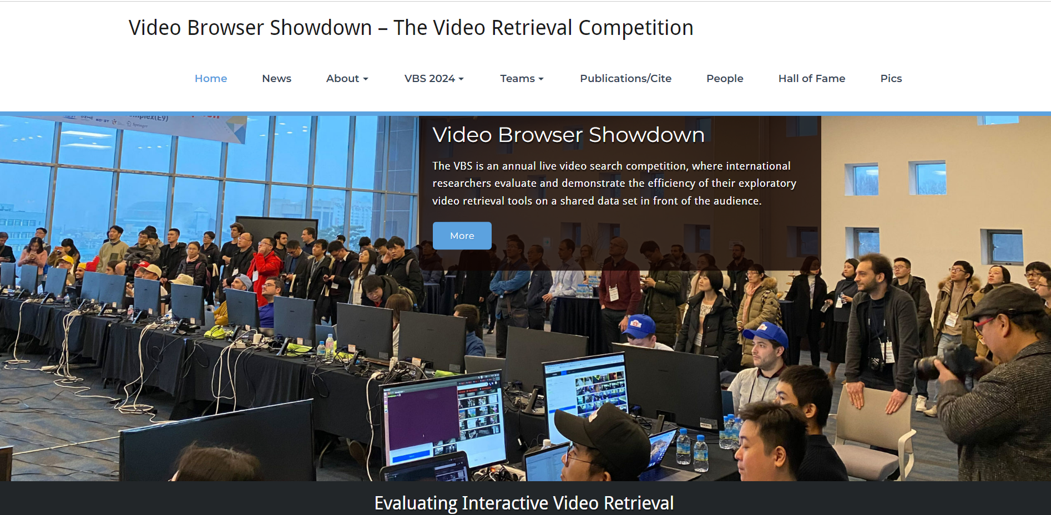
HCM AI Challenge 2023
AI VIETNAM
All-in-One Course
videobrowsershowdown.org
TA Hùng An

Slide 2
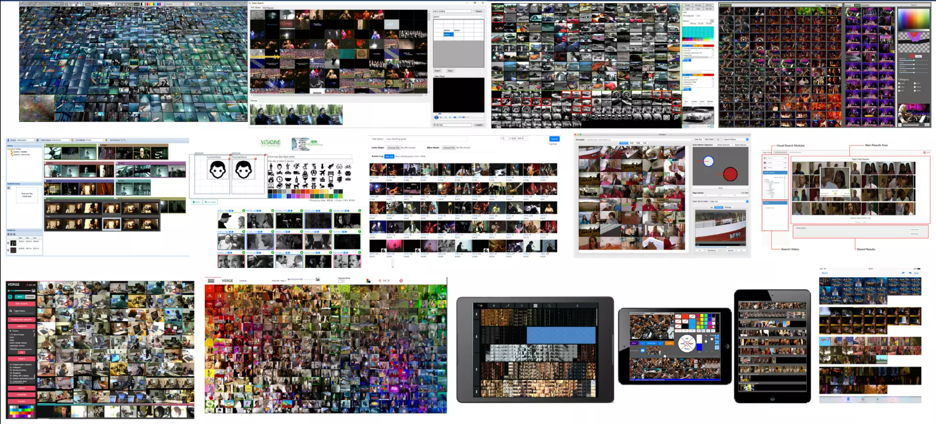
1 - VBS Tool
AI VIETNAM
All-in-One Course
Một số VBS Tools

Slide 3
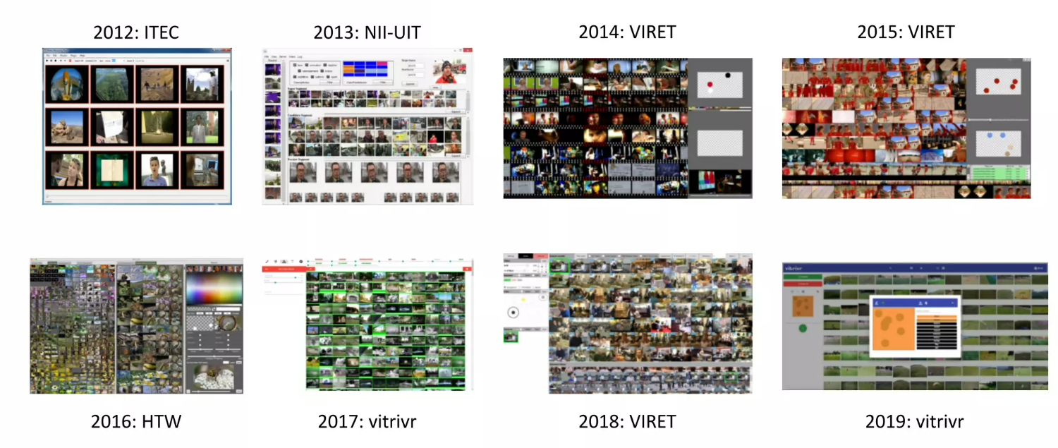
1 - VBS Tool
AI VIETNAM
All-in-One Course

Slide 4
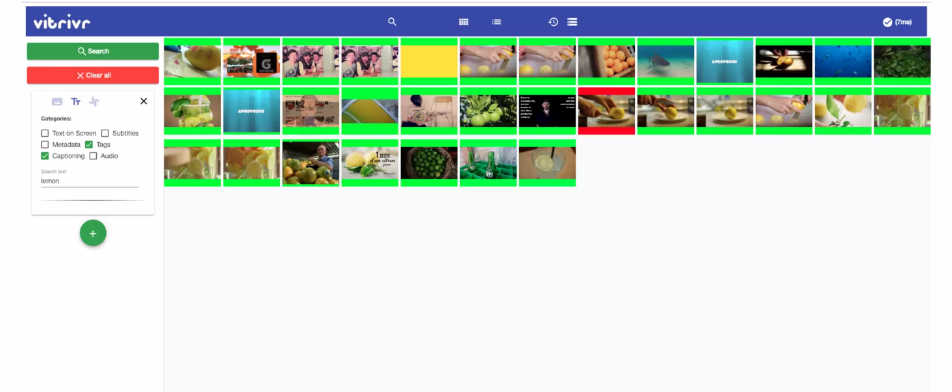
1 - VBS Tool
AI VIETNAM
All-in-One Course

Slide 5
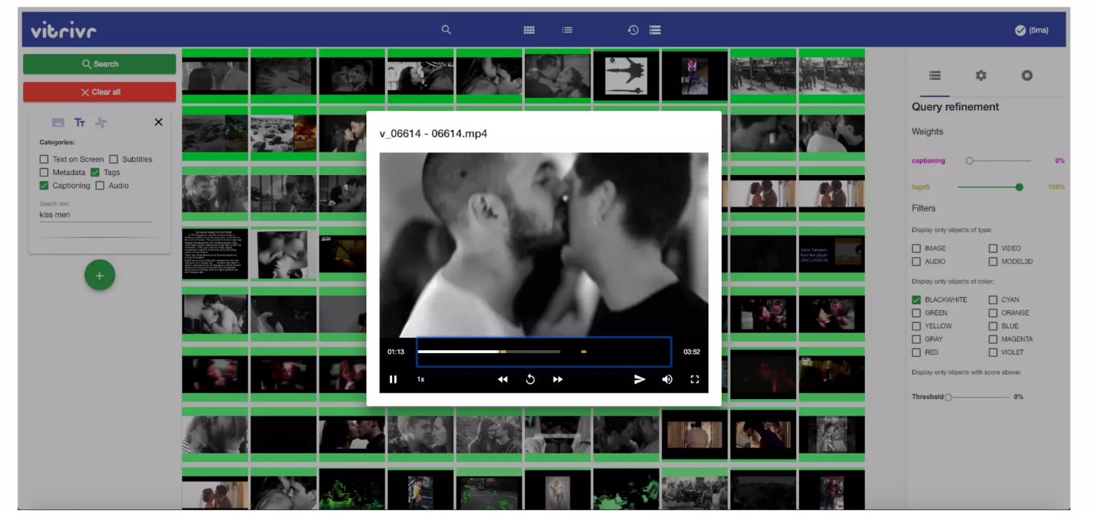
1 - VBS Tool
AI VIETNAM
All-in-One Course

Slide 6
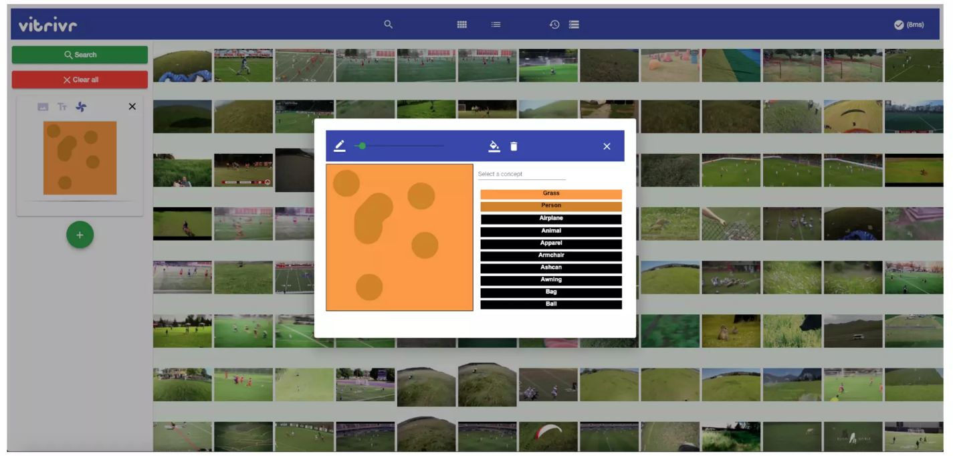
1 - VBS Tool
AI VIETNAM
All-in-One Course

Slide 7
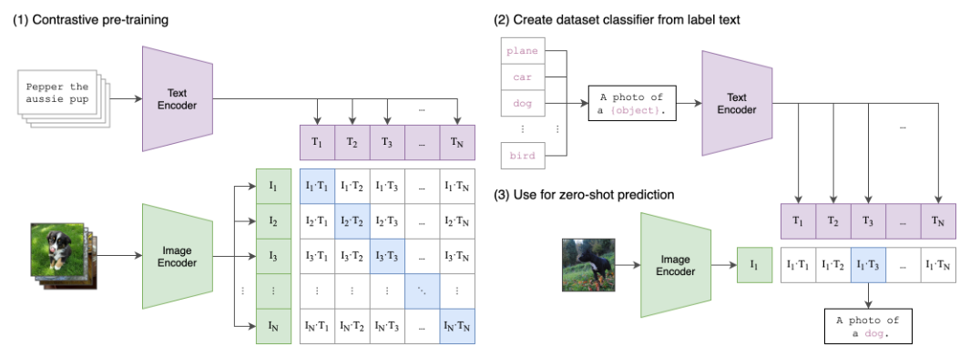
2 - CLIP
AI VIETNAM
All-in-One Course

Slide 8
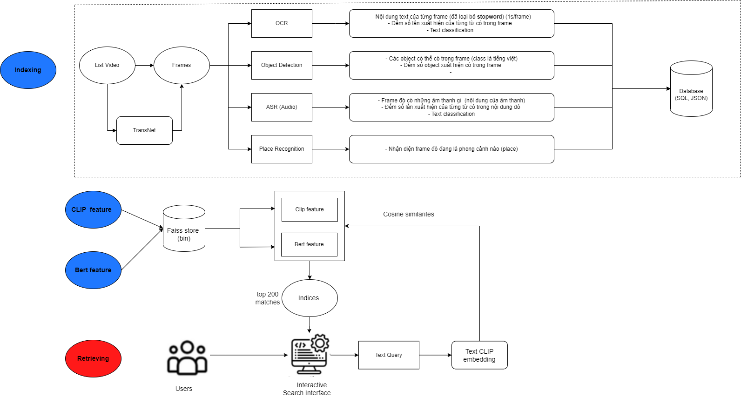
3 - Pipeline
AI VIETNAM
All-in-One Course

